Slide 1
STAR-PRODUCT AND TOMOGRAPHY OF QUANTUM STATES.
V.I. Manko
P.N.Lebedev Physical Institute, Moscow, Russia
Bregenz, July 2013

Slide 2



Slide 3





Slide 4



Slide 5




Slide 6



Slide 7




Slide 8


Slide 10
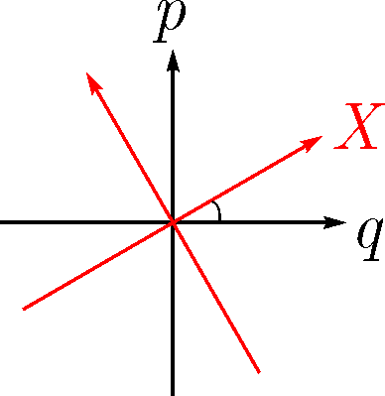
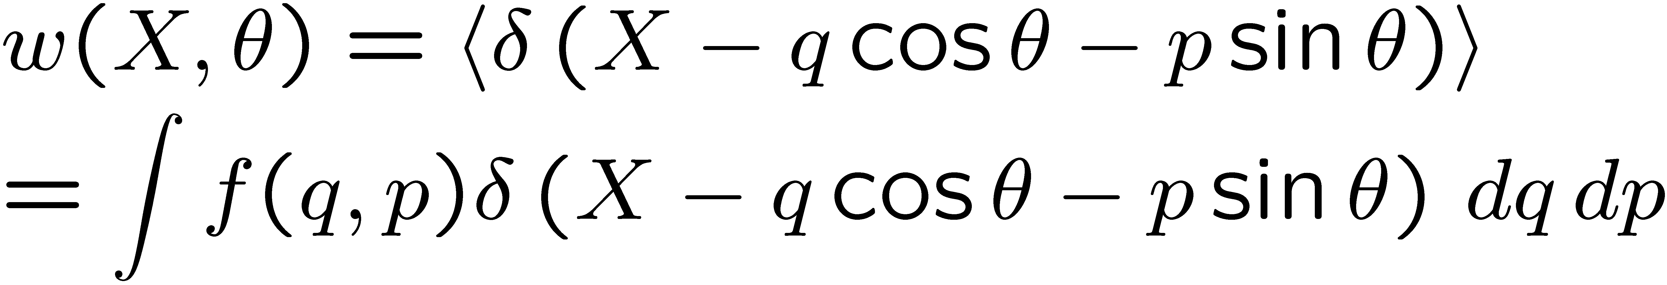

Slide 11
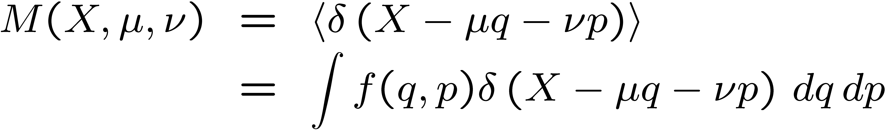
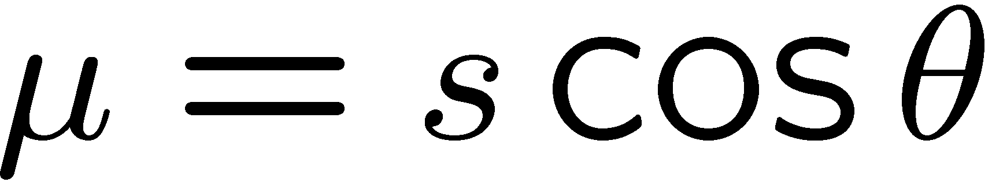
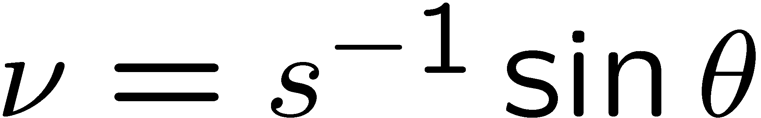
Man'ko, O. V., Man'ko, V. I., J. Russ. Laser Res. 18, 407--444 (1997)

Slide 12
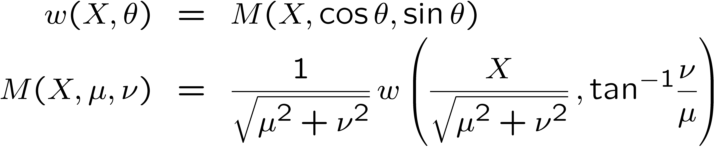

Slide 14
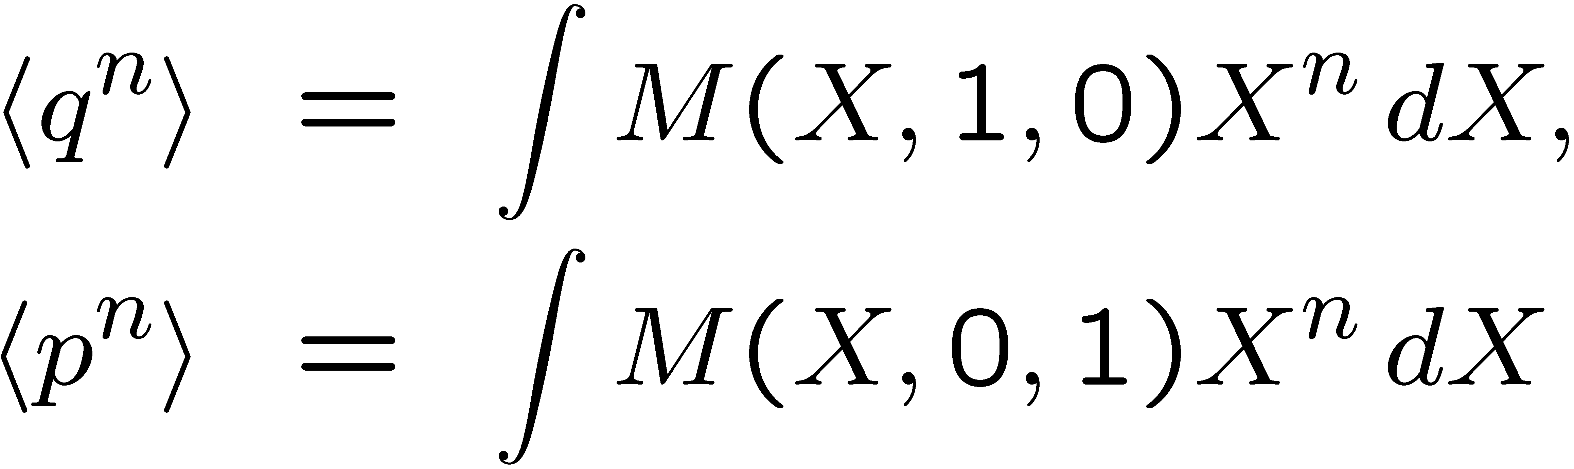

Slide 15

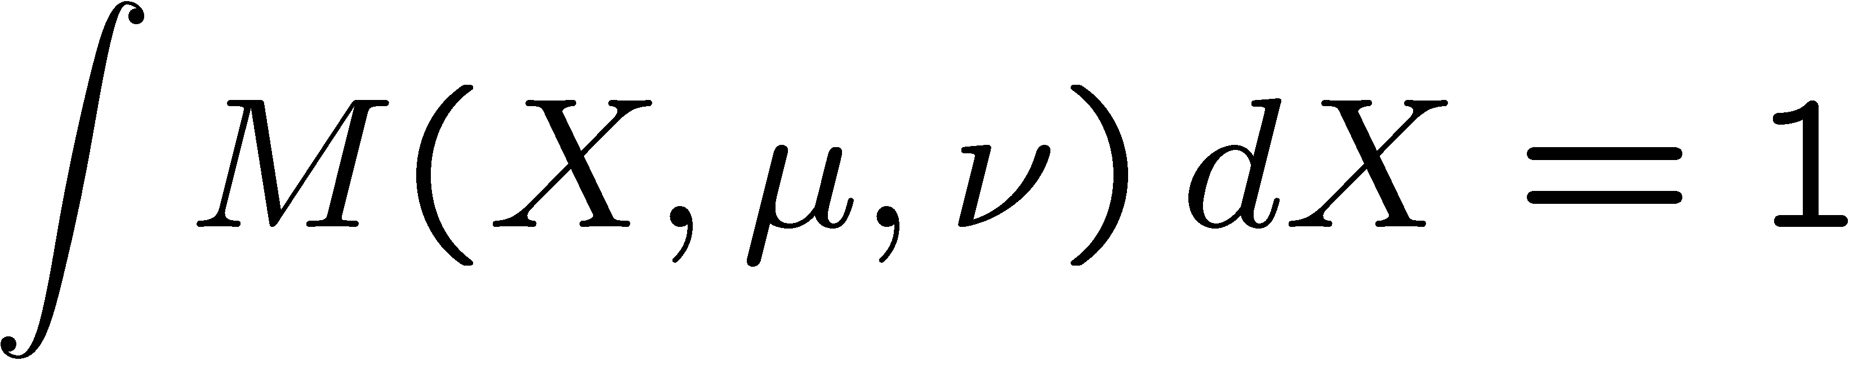
Quantum Picture
Mancini, S., Man'ko, V. I., Tombesi, P, Found. Phys. 27, 801-824 (1997).

Slide 16
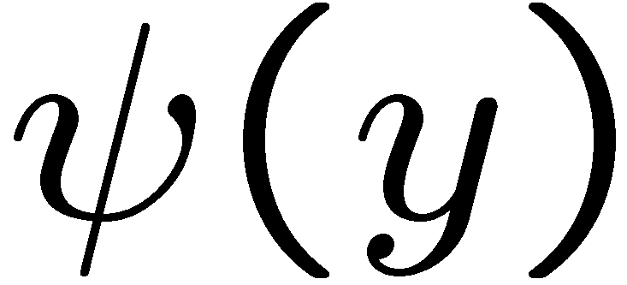
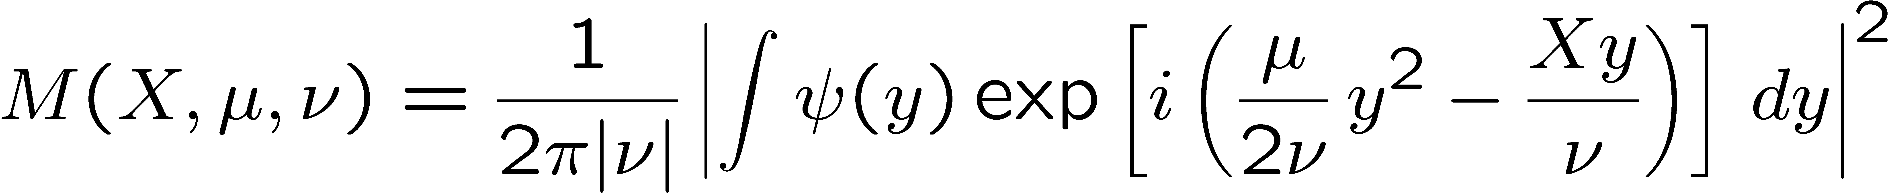
Man'ko V. I., Mendes, R. V, Phys. Lett. A 263, 53--56 (1999) [ArXiv Physica/9712022]

Slide 17
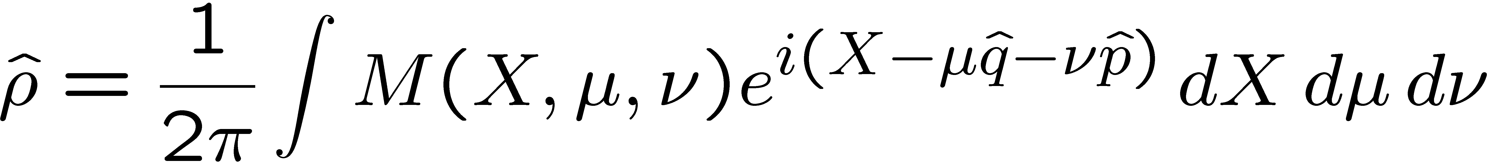
See also review:
Ibort, A., Man'ko, V. I., Marmo, G., Simoni, A., Ventriglia F., Phys. Scr. 79, 065013 (2009)

Slide 18
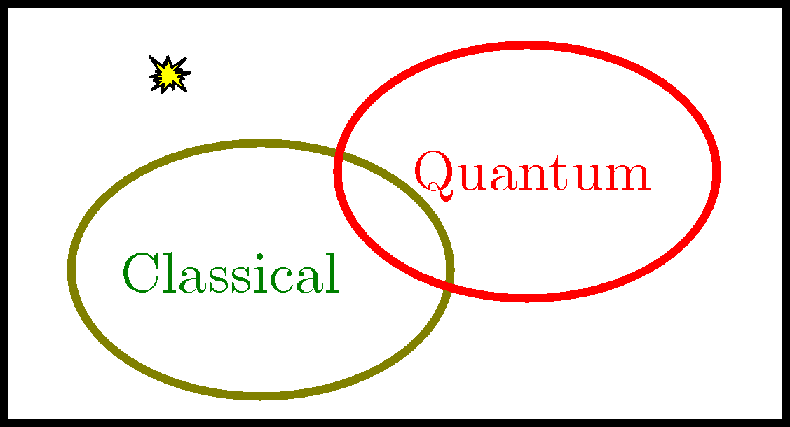
Review “An introduction to the tomographic picture of quantum mechanics”
Ibort, A., Man'ko, V. I., Marmo, G., Simoni, A., Ventriglia F., Phys. Scr. 79, 065013 (2009)

Slide 19
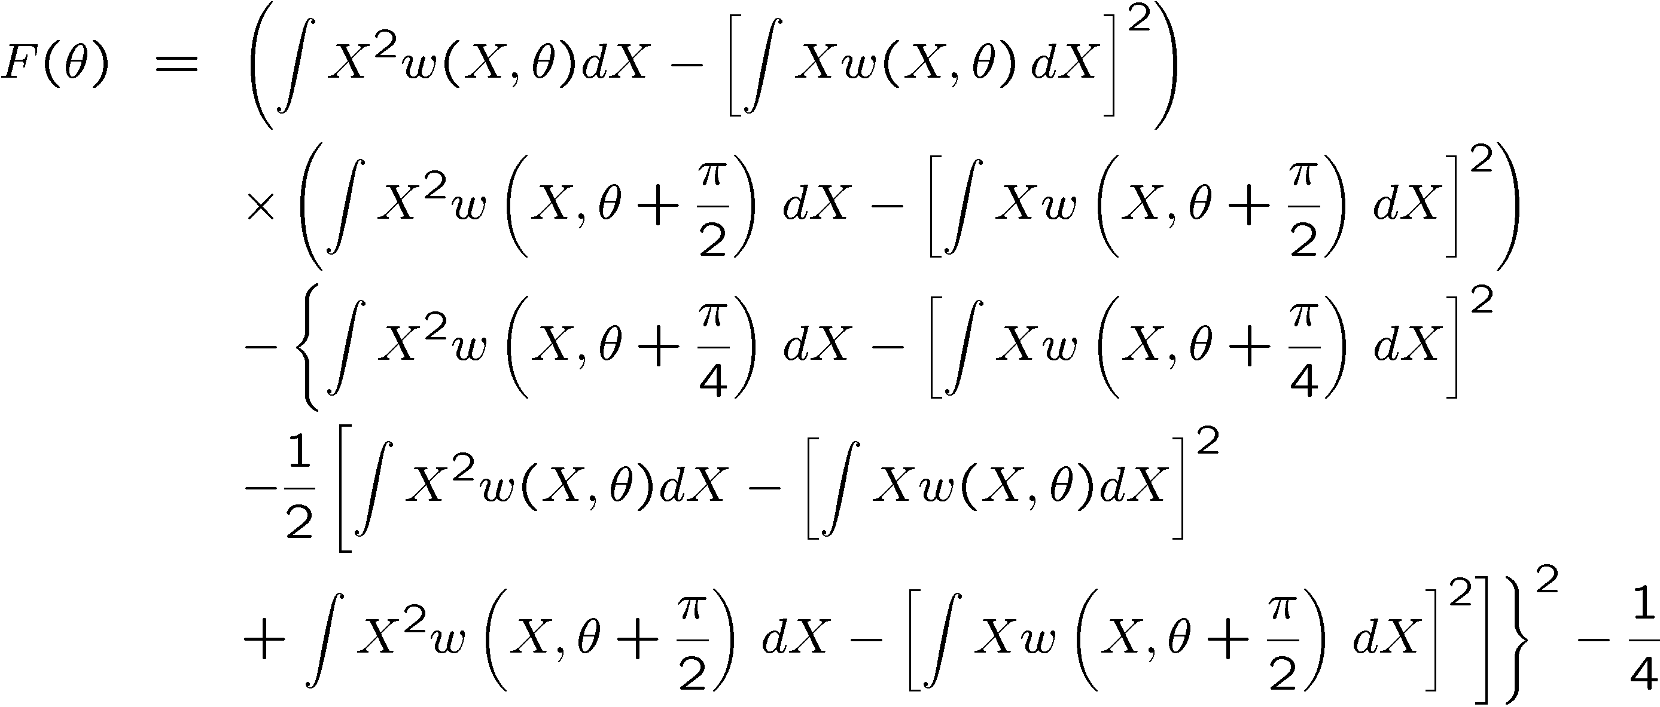
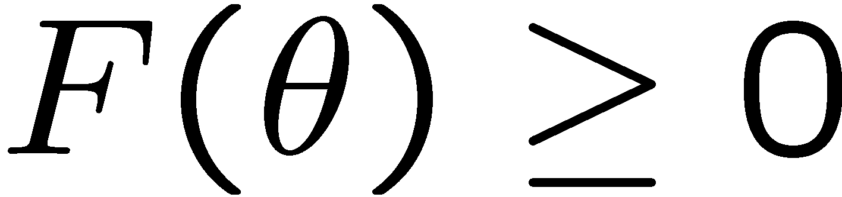
Man'ko, V. I., Marmo, G., Simoni, A., Ventriglia F., Adv. Sci. Lett. 2, 517-520 (2009)

Slide 20
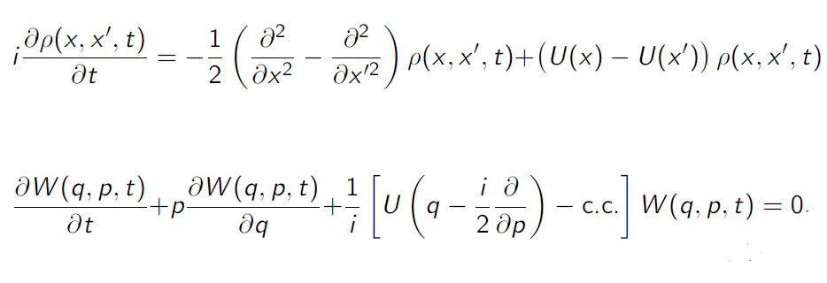

Slide 21
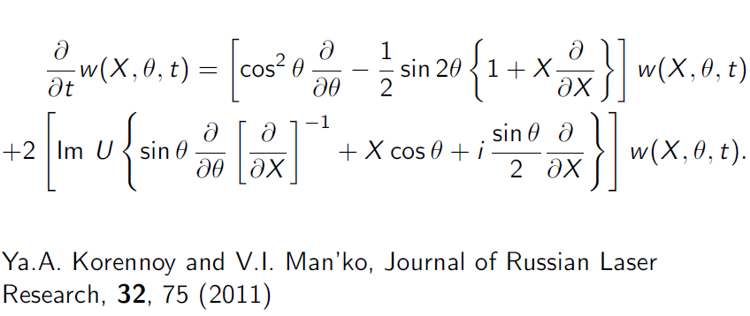

Slide 22
Collaborations
Ibort, A., Man'ko, V. I., Marmo, G., Simoni, A., Ventriglia F., Phys. Scr. 79, 065013 (2009)
Mancini, S., Man'ko, V. I., Tombesi, P, Found. Phys. 27, 801-824 (1997)
Man'ko V. I., Mendes, R. V, Phys. Lett. A 263, 53--56 (1999)
Man'ko O. V., Man'ko V. I., J. Russ. Laser Res. 18, 407--444 (1997)
Ya. A. Korennoy, V. I. Man’ko, J. Russ. Laser Res. 32, 75 (2011)
Bellini, A.S. Coelho, S.N. Filippov, V.I. Man'ko, A. Zavatta. Phys. Rev. A 85, 052129 (2012)
Chernega V. N.; Man'ko V. I. AIP Conference Proceedings, Volume 1424, pp. 33-39 (2012)

Slide 23
Conclusions
We reviewed the probability representation of quantum mechanics, where the quantum states are described by probability distributions as an alternative to density operators.
The probability representation is discussed for continuous variables.
Star- product schemes for quantum tomography and Moyal formulations of quantum mechanics are reviewed.

